Slide 1
Introduction to data base

Slide 2
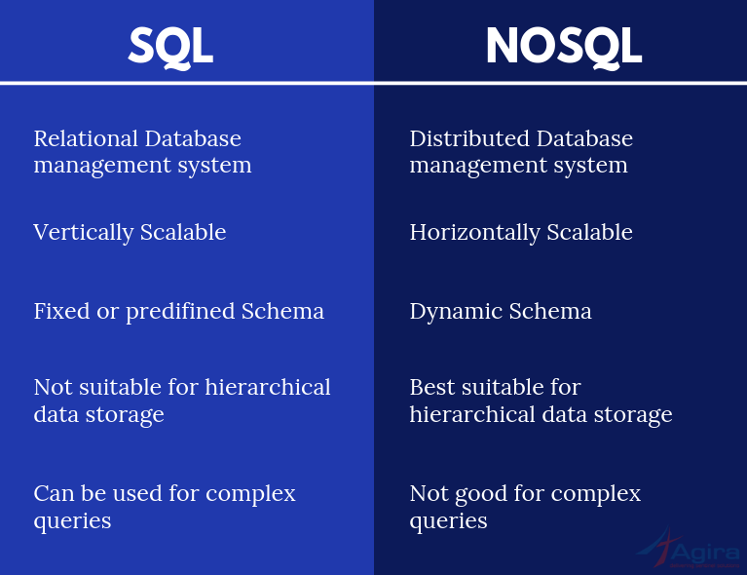
SQL VS NOSQL

Slide 3
MySQL
What is MySQL :
MySQL is an open-source relational database management system (RDBMS) Uses tables as the main component Offers less functionality than PostgreSQL.
Features OF MySQL : Security and authentication Client server execution and remote database access Embedded SQL Transaction Control Language.

Slide 4
PostgreSQL
What is PostgreSQL :
An advanced, enterprise-class, and open-source relational database system A highly stable database Used as a primary database for many web applications General purpose transaction database Language support : Python ,Java ,JavaScript (Node.js)...
Features OF PostgreSQL : Can run dynamic websites and web apps as a LAMP stack option. Freely available under an open source license Asynchronous replication… Table inheritance Sophisticated locking mechanism

Slide 5
SQL Server
What is SQL Server :
A Relational Database Management System (RDBM) Developed and operated by Microsoft. It's manages and performs all the database operations. It has both command-line and GUI(Graphical User Interface)
Features OF SQL Server : High availability management. Support for geographic data. Centralized management and deployment of multiple instances and applications from a single point of control.. Programmability..

Slide 6
MySQL VS PostgreSQL VS SQL Server
MySQL : A relational database management system. Most popular open source database Not extensible.
PostgreSQL : Available as free and open source software in perpetuity An object-relational database management system. More advanced and Highly extensible. Provides online backup. Most advanced open source database PostgreSQL does not have a native data type for geographic data.
SQL Server : Available through commercial license and can be licensed on a per-core model or server and client access level (CAL) model. Use a variant of Structured Query Language (SQL) called T-SQL (for Transact-SQL) SQL Server has the geography data type for storing geographic spatial data. Easy to use and reliable, with strong .NET compatibility.

Slide 7
Mongo DB
Mongo DB is a source-available cross-platform document-oriented database program. Classified as a NoSQL database program, Mongo DB uses JSON-like documents with optional schemas,

Slide 8
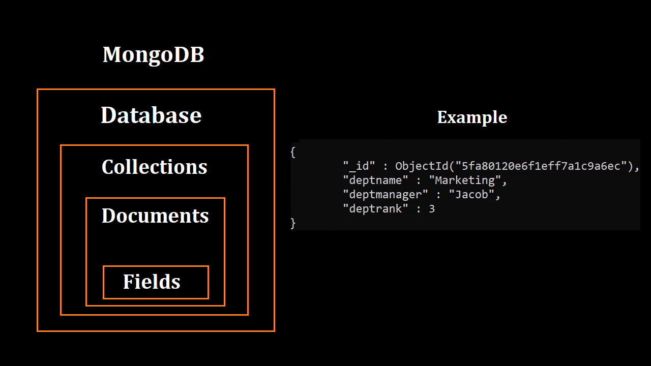

Slide 9
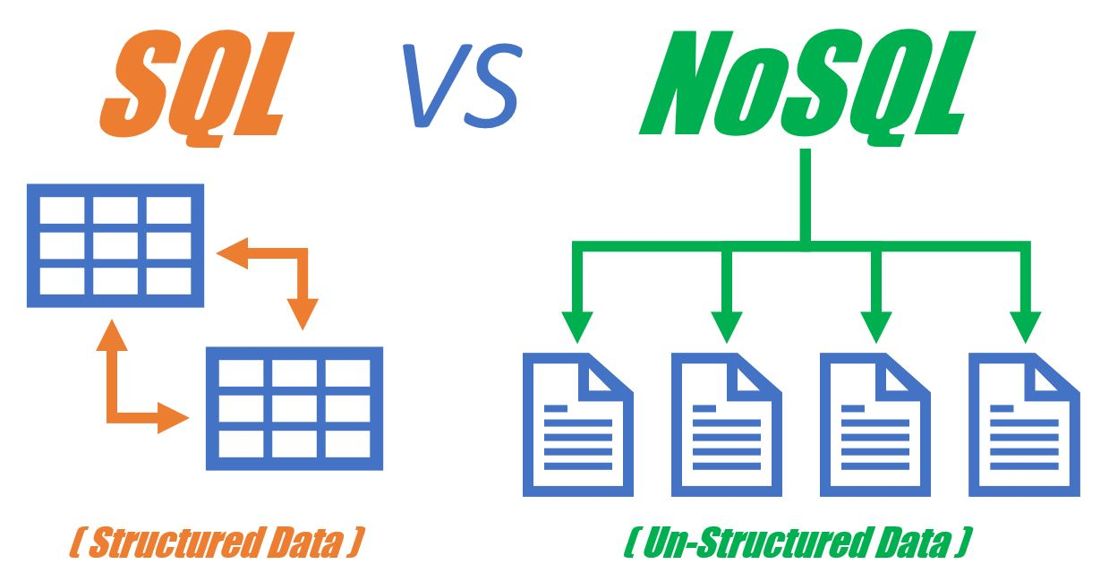

Slide 10


